Slide 1
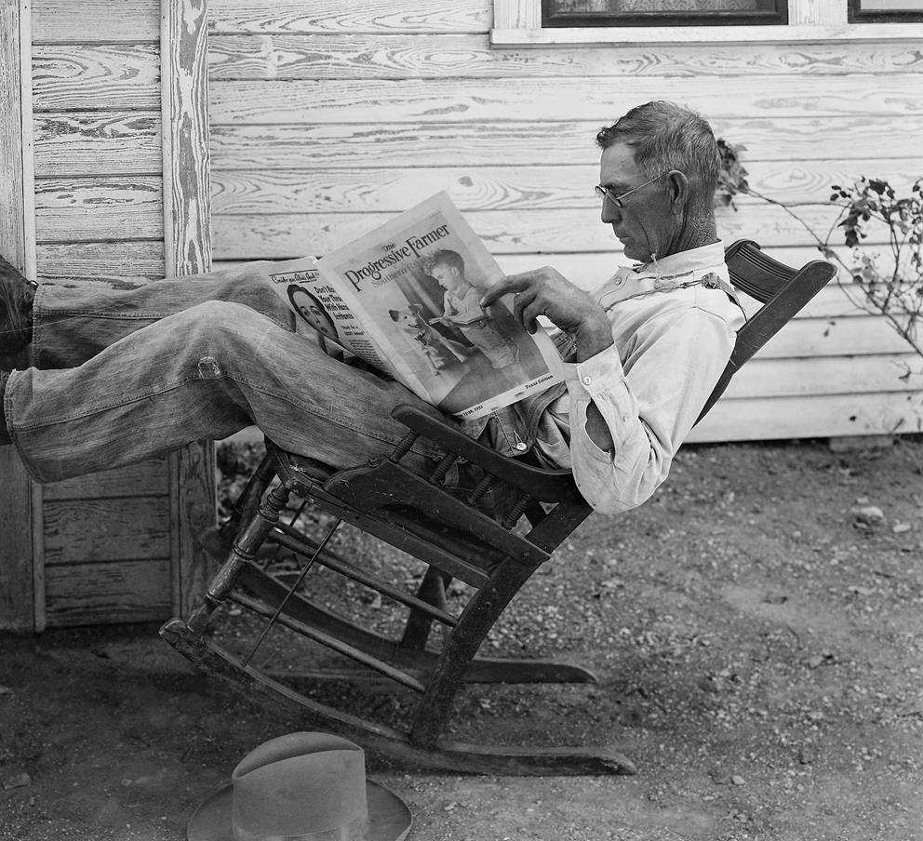
Reading
Strategies for Reading

Slide 2
WHAT do we read?

Slide 3
What do we read?
Newspaper
Magazine
Books
Mail
Bills
Dr. notes
Texts
Email
Signs
directions

Slide 4
HOW DO WE Read?
There are four types of reading skills
Skimming
Scanning
Intensive Reading
Extensive Reading

Slide 5
skimming
Skimming is used to quickly gather the most important information or gist. This is done by running your eyes over the text, remembering important information. Use skimming to quickly get the main idea.
What do we skim
  Newspapers
  Magazines
  Business and travel brochures

Slide 6
Scanning
Scanning is used to find a particular piece of information. This is done by running your eyes over the text looking for the specific piece of information you need. You scan the following:
  Train/airplane schedule
  Conference guide
  TV listing
Notes:
Consider talking about:
Types of tests

Slide 7
Intensive reading
Intensive reading is used on shorter texts in order to get specific information. It is close accurate reading for detail. You need to know specifics. Examples are:
  Insurance claim
  A contract
  A prescription
  A doctor’s note

Slide 8
Extensive reading
Extensive reading is used to get general understanding of the subject. It includes reading longer texts for pleasure. Examples are:
  A novel
  A magazine
  A biography
Notes:
Consider talking about:
Lighting

Slide 9
Good reading habits!
Read entire section on your first time through (even if you don’t understand words). After first reading, you can go back and read sections you didn’t understand.
If you use your finger to guide you, be sure to keep your finger ahead of your eyes.
Read the text in small chunks: try to read phrases or sentences rather than single words in isolation.
Read, read, read! Always keep reading – in class and at home.

Slide 10

The reader as a detective
A good reader is a detective!
  You must find the solution to the problem/mystery
    With each chapter, you ask yourself
      Who, what, when, where, why, and how
  Look for clues
    Look at titles or subtitles
  Ask intelligent questions BEFORE starting to read
  Look at the author. Who is the author? What other books as she/he written?

Slide 11
Annotating a reading text
You have been given a paragraph. Practice how to annotate your reading as a group.

Slide 12
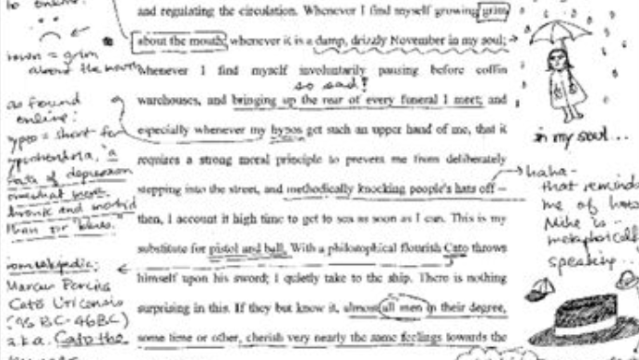

Slide 13
Four stations
You have been given a story. It is not in the correct order. Like a detective, figure out the order of the story. Once you have the correct order, write a summary of the story.

Slide 14
Rewrite the Ending and change the moral of the story
Now you know your story. As a group, write a different ending to the story. Read it to the class.

Slide 15
Text genre scan http://mendotarailmuseum.tripod.com/sitebuildercontent/sitebuilderpictures/amtrakschedule.jpg skim bring in travel brochures intensive https://www.bookkeeping-essentials.com/images/sample-is.png

Slide 16
To print/bring in to supplement lp
Successful language learners article for annotation
Four stories (cut up and re-arrange)

