Slide 1
Grandma Glenn’s Cookies
Presented by: Professor Glenn

Slide 2
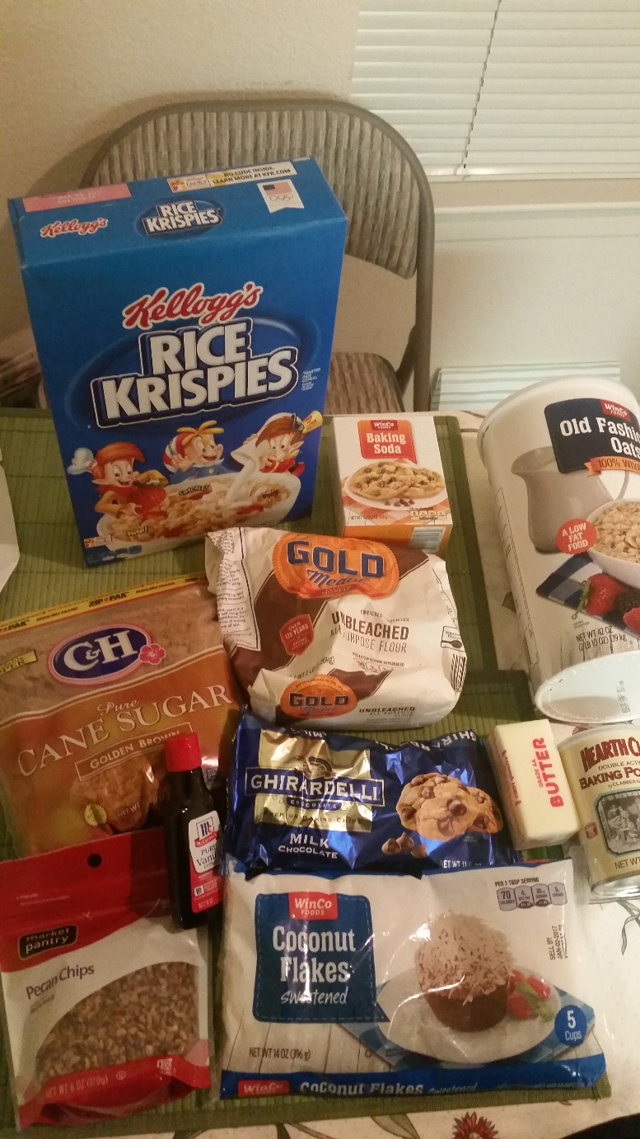
The Ingredients
½ Cup Butter
½ Cup Brown Sugar
½ Cup White Sugar
1 Egg
1 Cup Flour
½ Teaspoon Baking Powder
1 Teaspoon Baking Soda
1 Cup Rice Krispies
1 Cup Oatmeal
½ Cup Pecans
6oz Chocolate Chips (Ghiradelli is the best)
½ Coconut

Slide 3
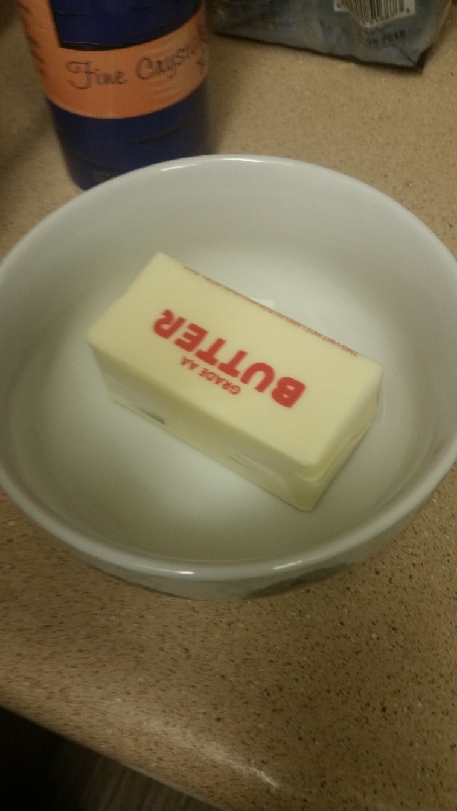
Begin by Softening the Butter

Slide 4
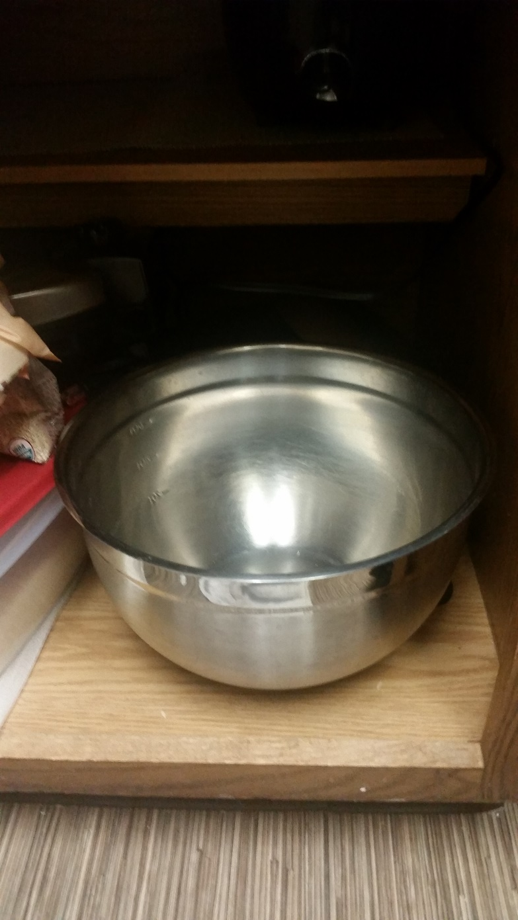
Then Grab a Mixing Bowl

Slide 5
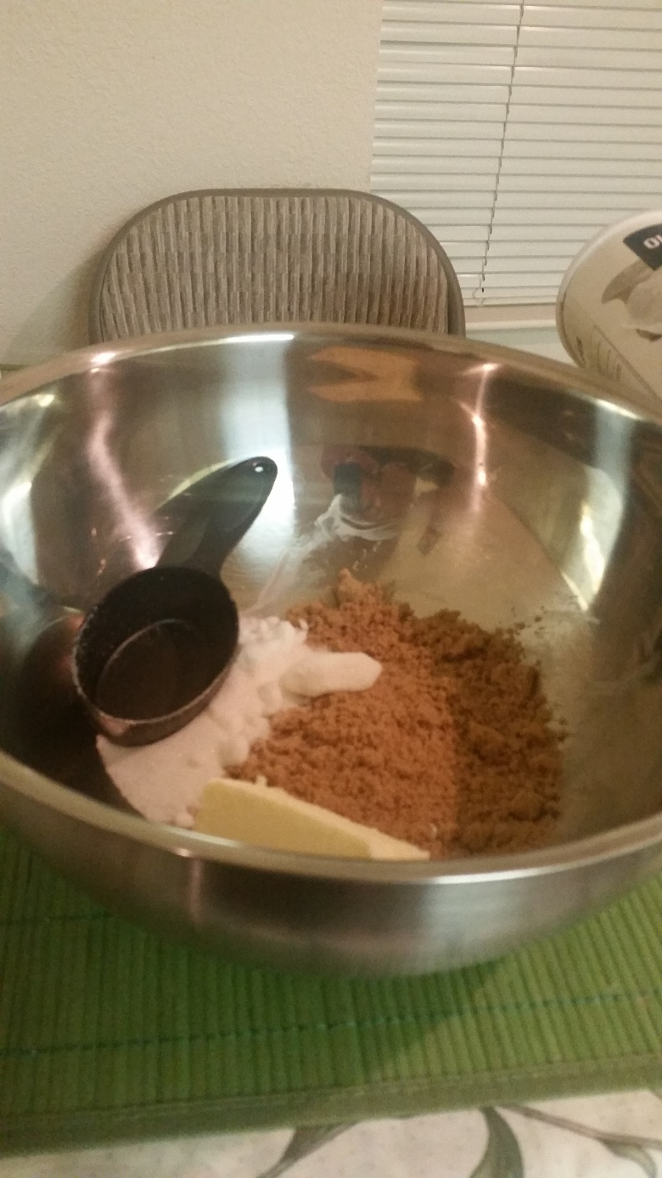
Next Mix Both Sugars with Butter

Slide 6
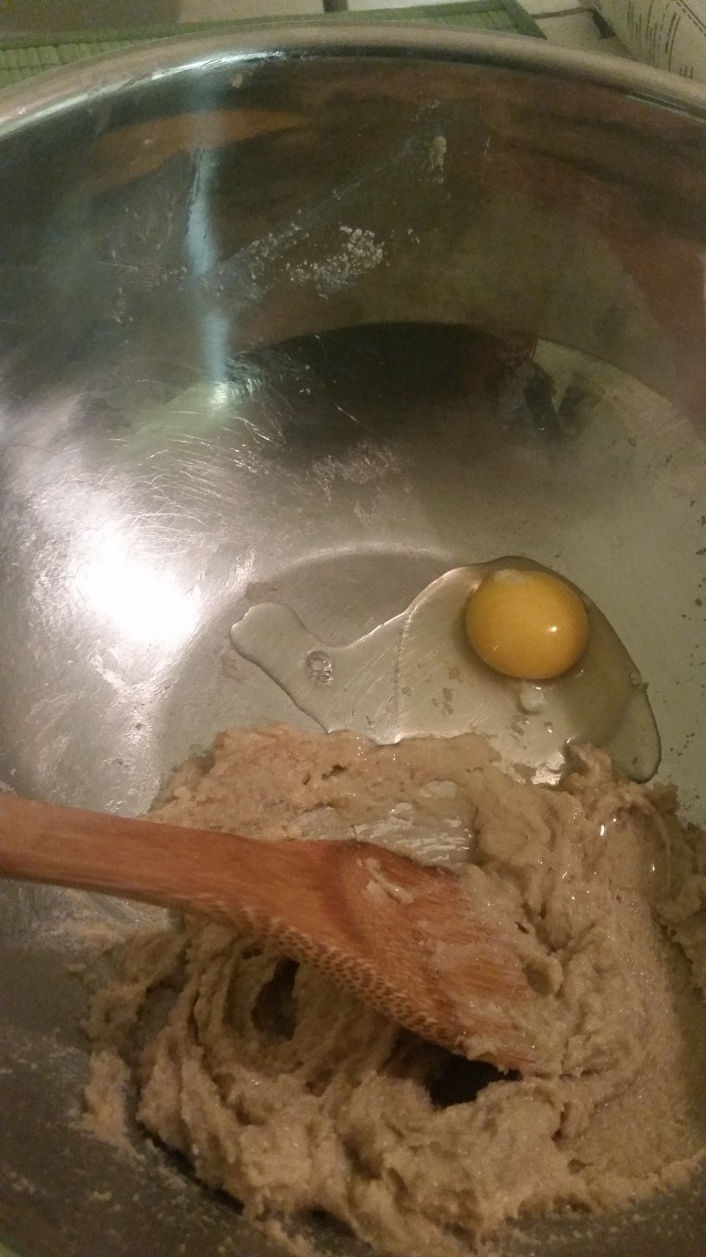
Add an Egg to the Mix

Slide 7
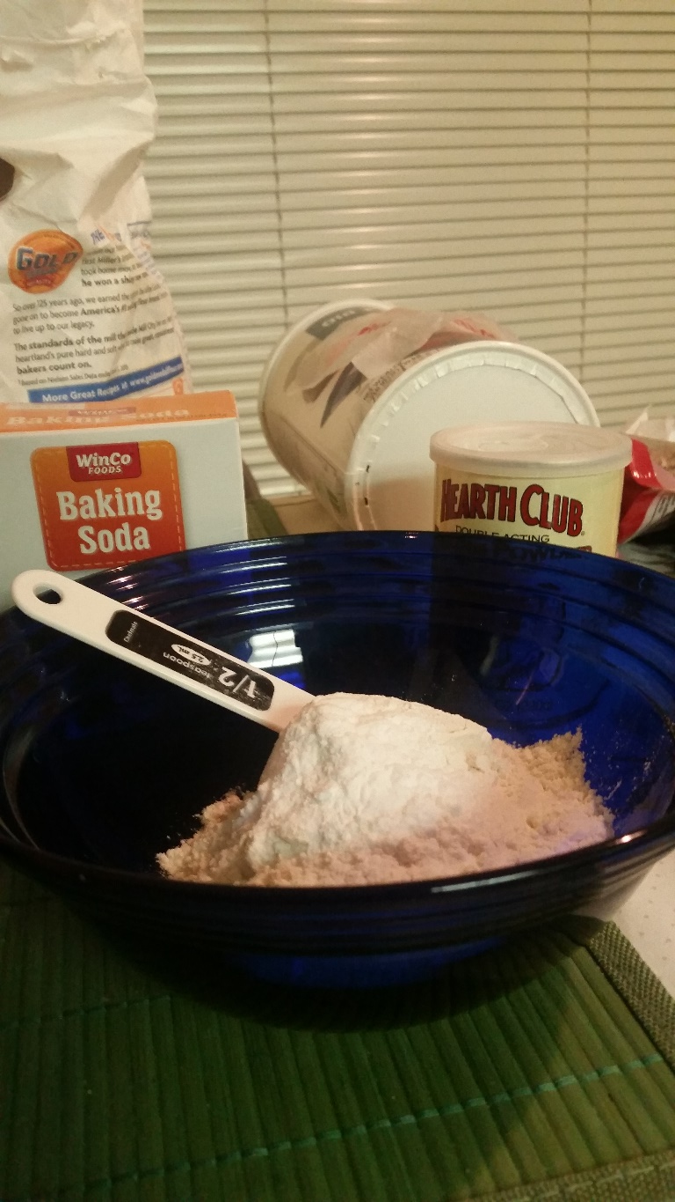
Next Mix the Dry Ingredients Separately

Slide 8
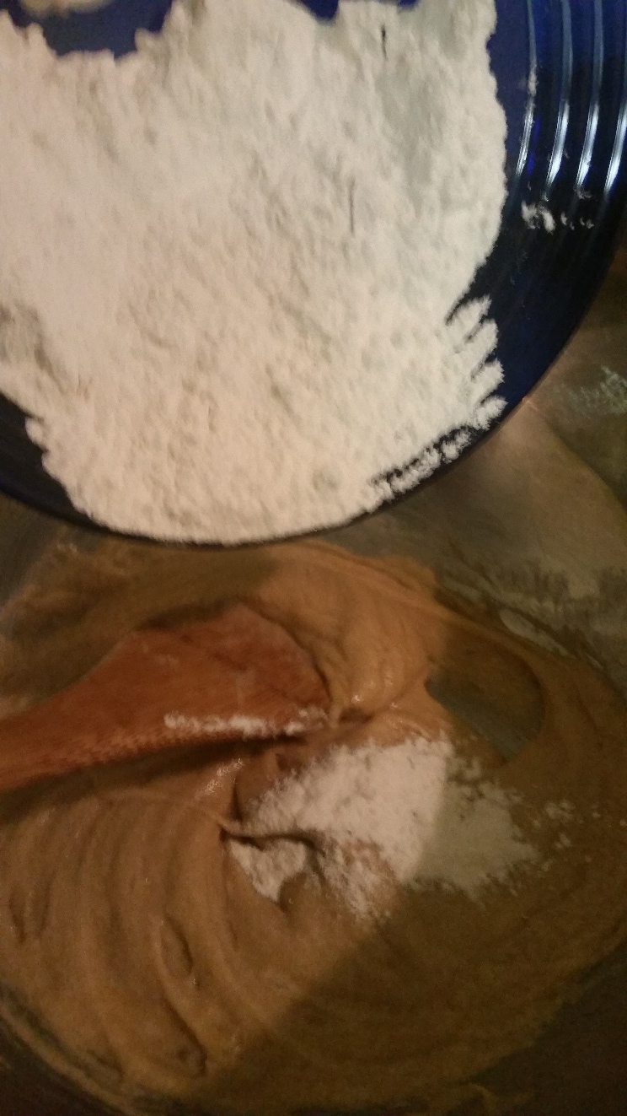
Combine

Slide 9
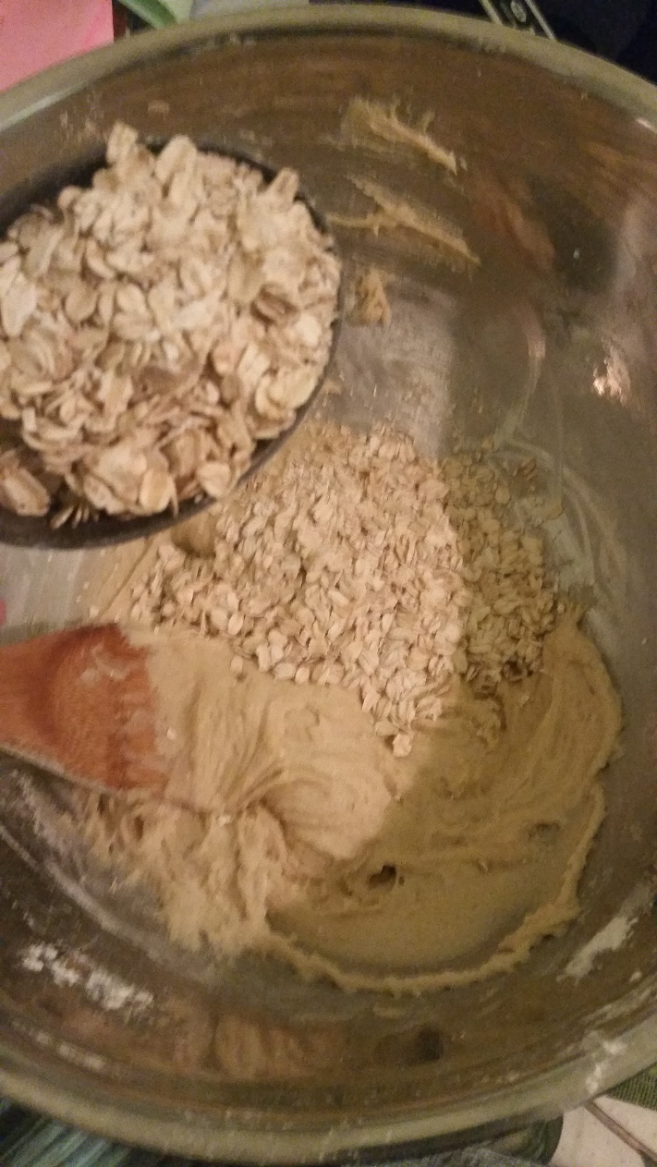
Throw in the Oatmeal

Slide 10
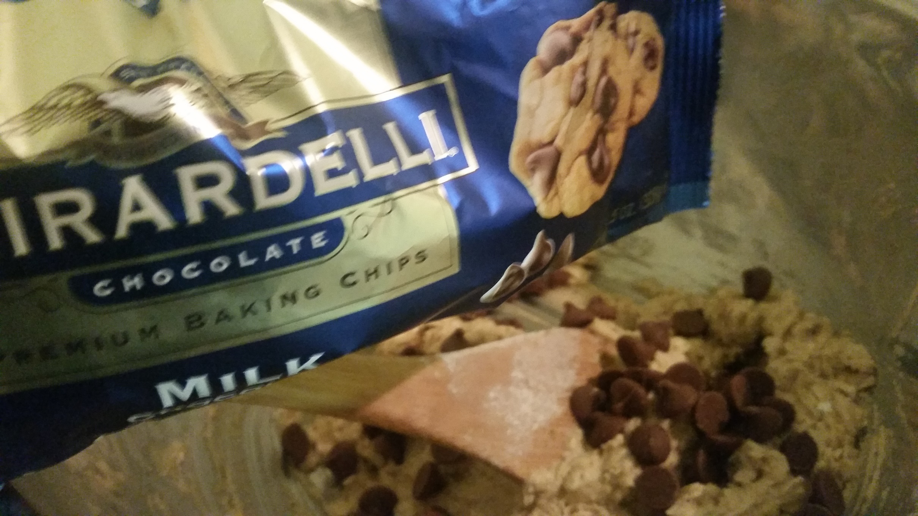
The Best Part

Slide 11
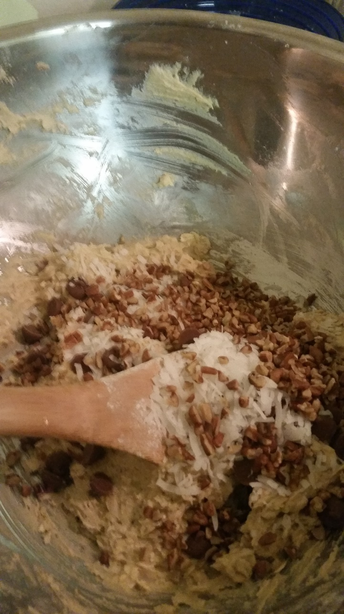
Pecans and Coconut

Slide 12
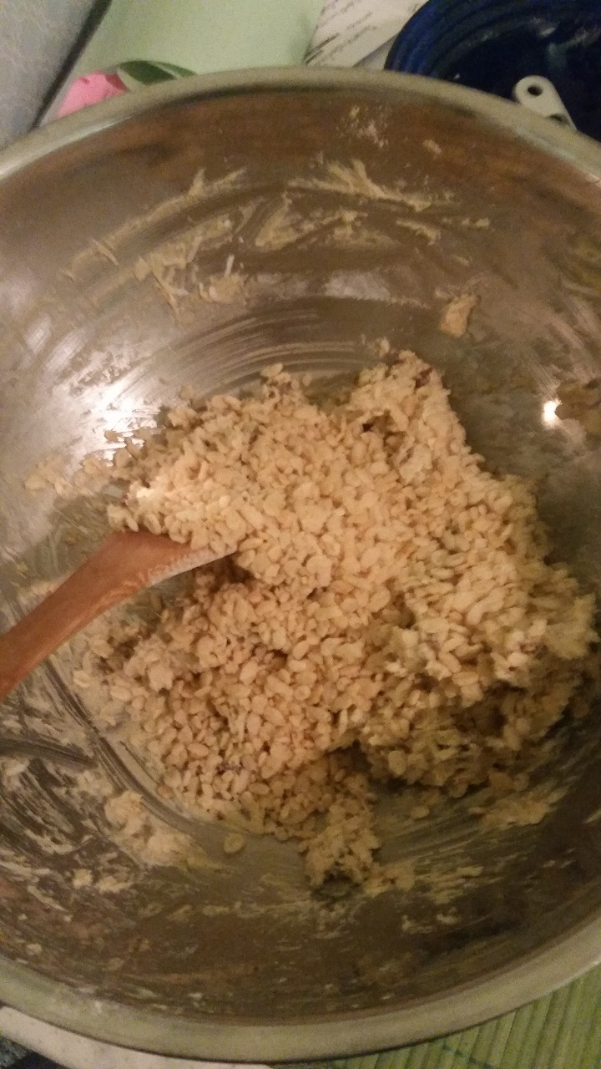
Don’t Forget Rice Krispies

Slide 13
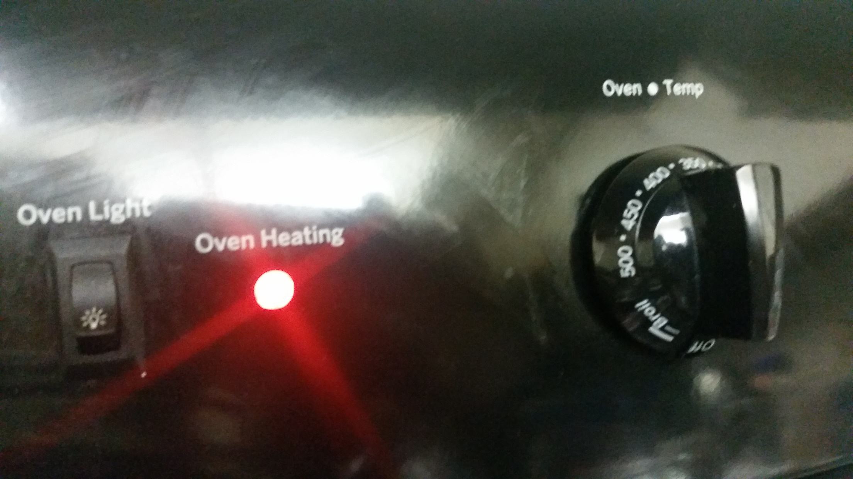
Turn on the Oven

Slide 14
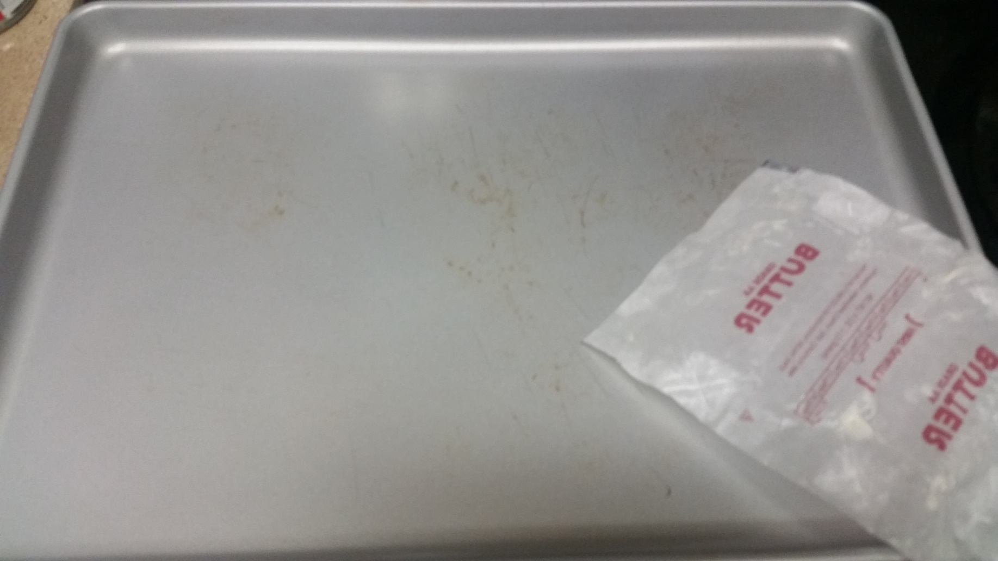
Butter the Cookie Sheet

Slide 15
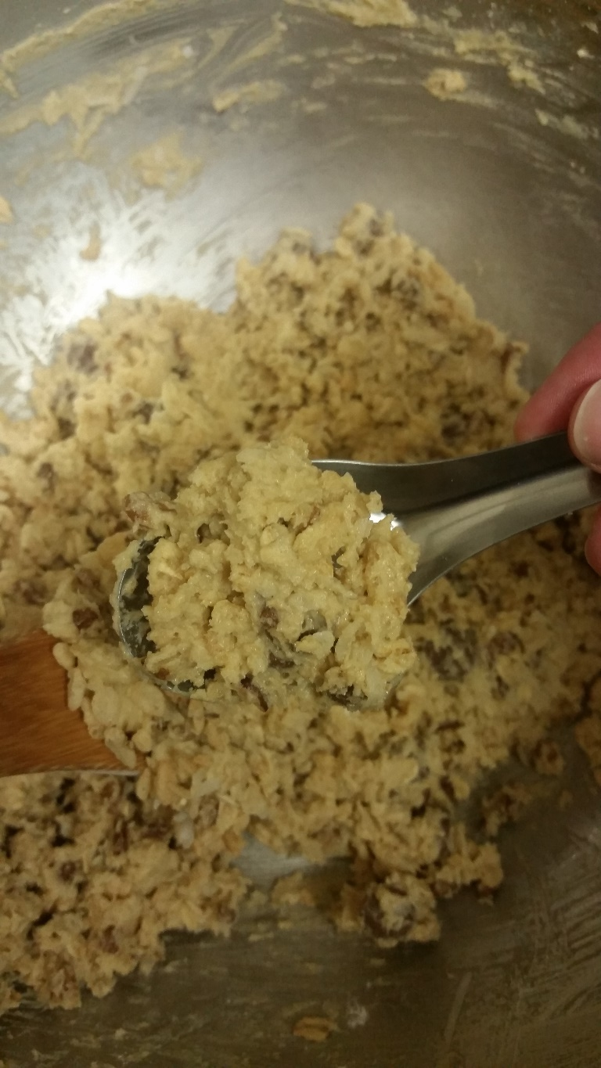
Scoop with a Table Spoon

Slide 16
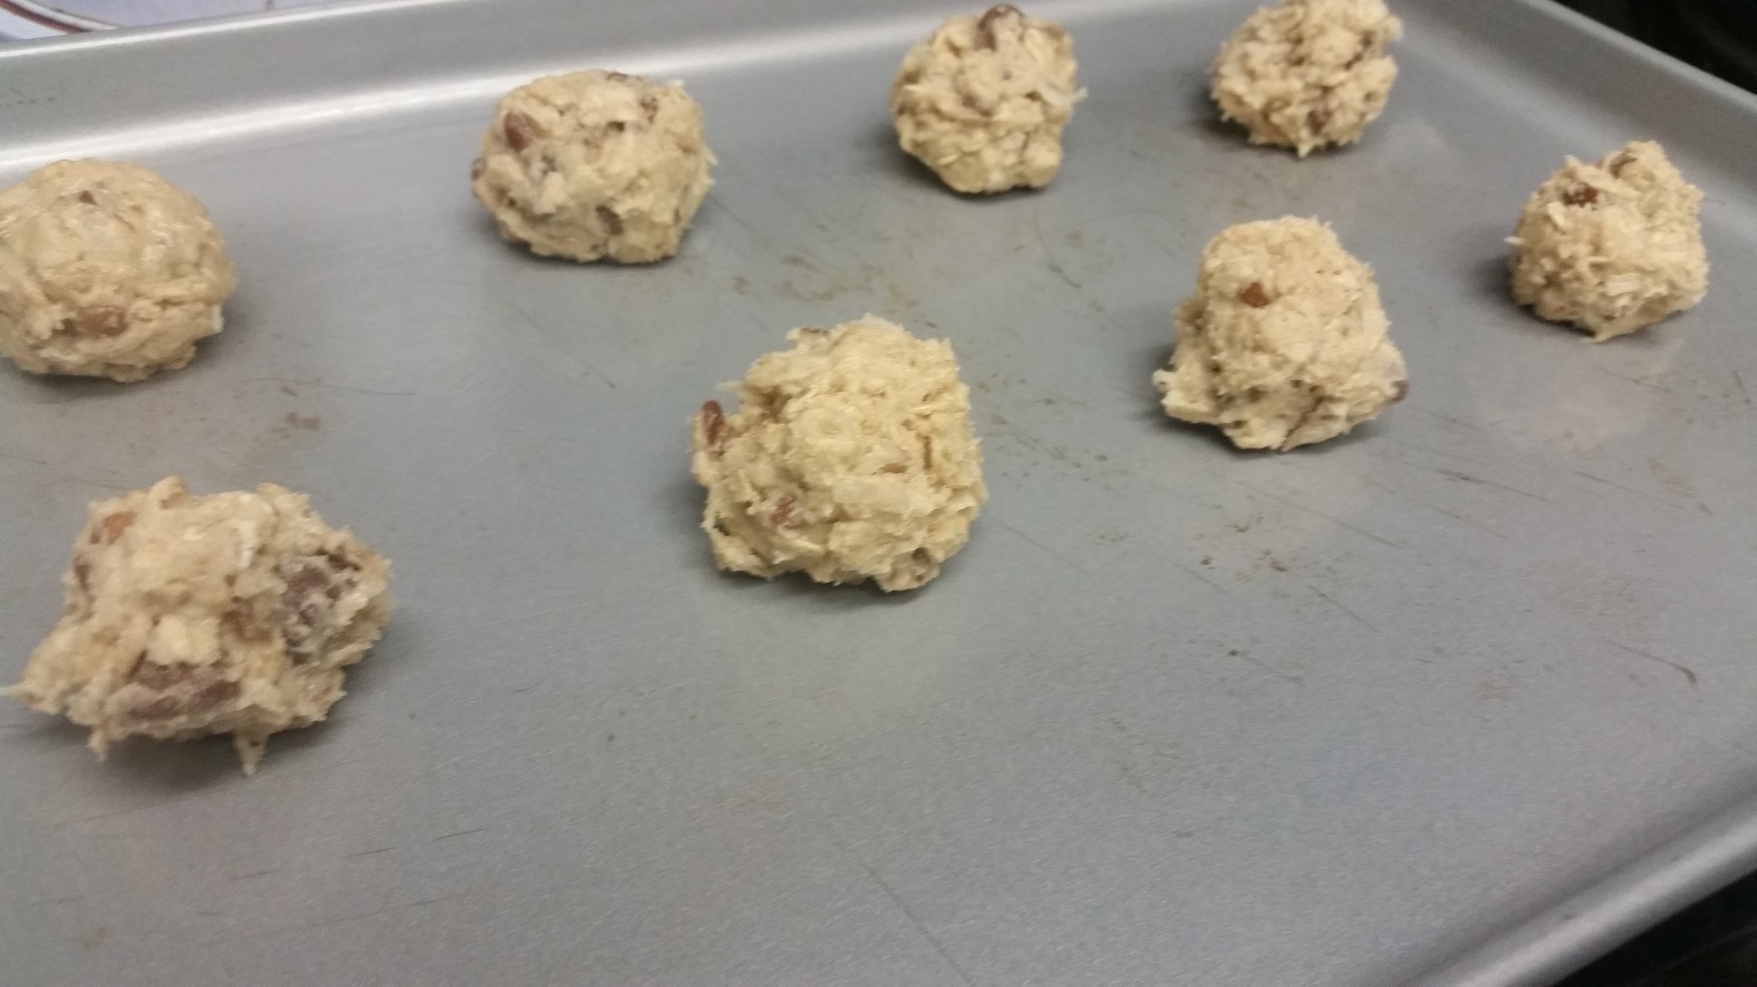
Form Balls with Hands/Spoon

Slide 17
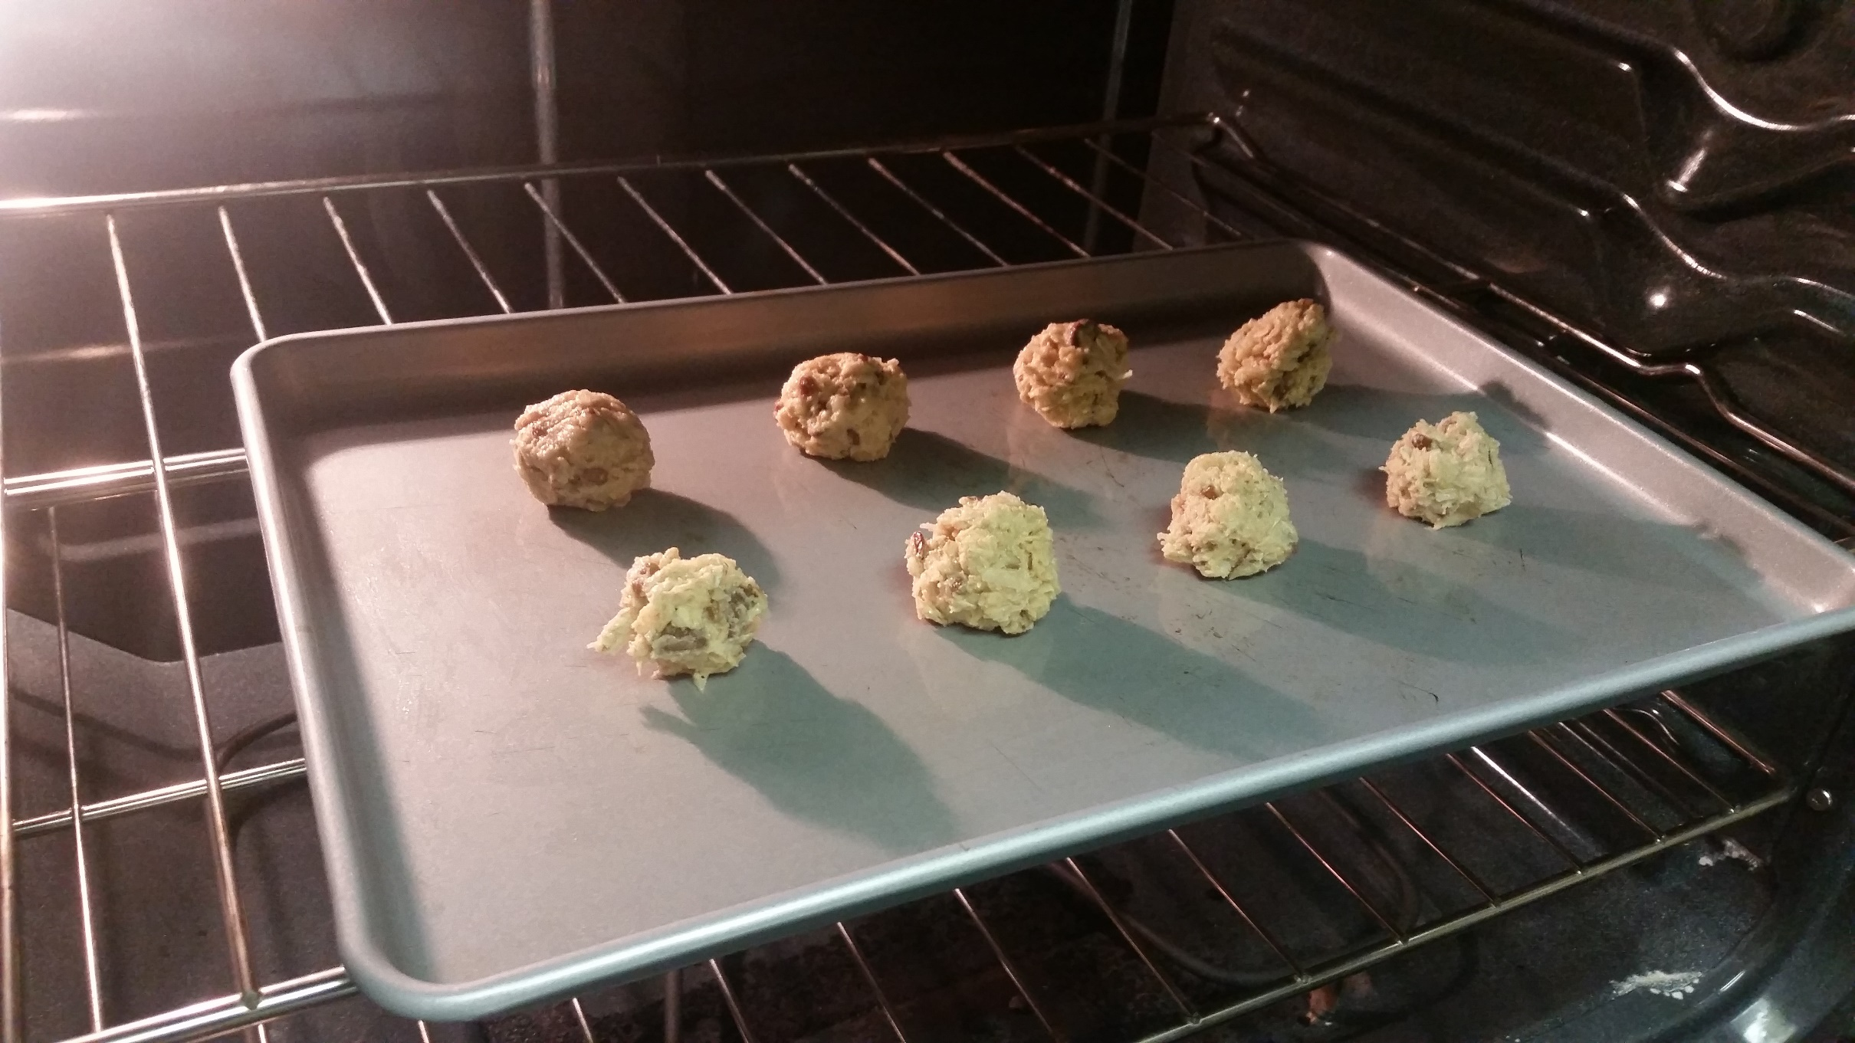
Set in the Oven

Slide 18
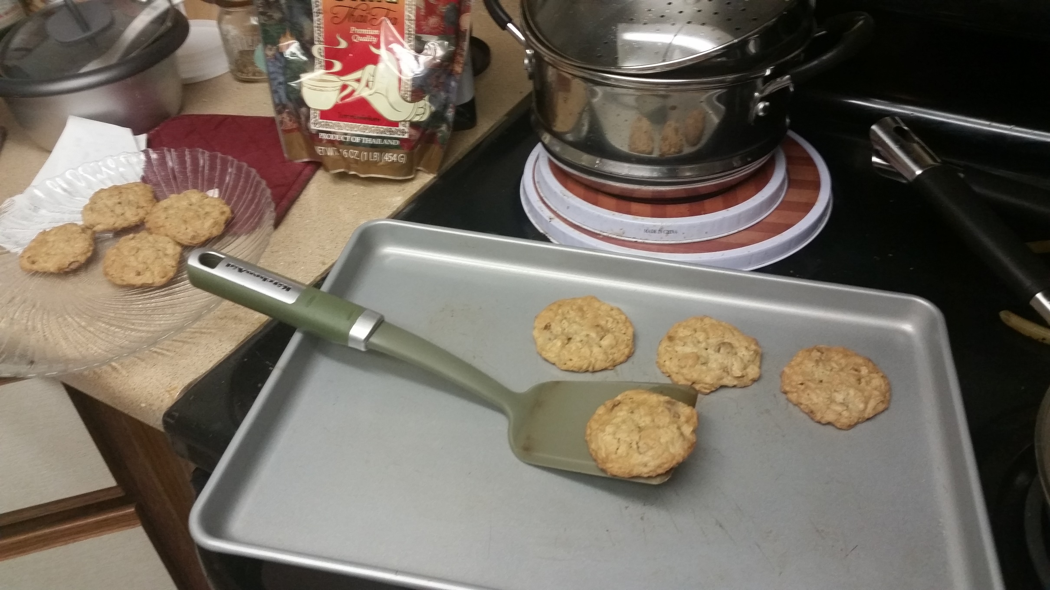
Wait if Possible

Slide 19
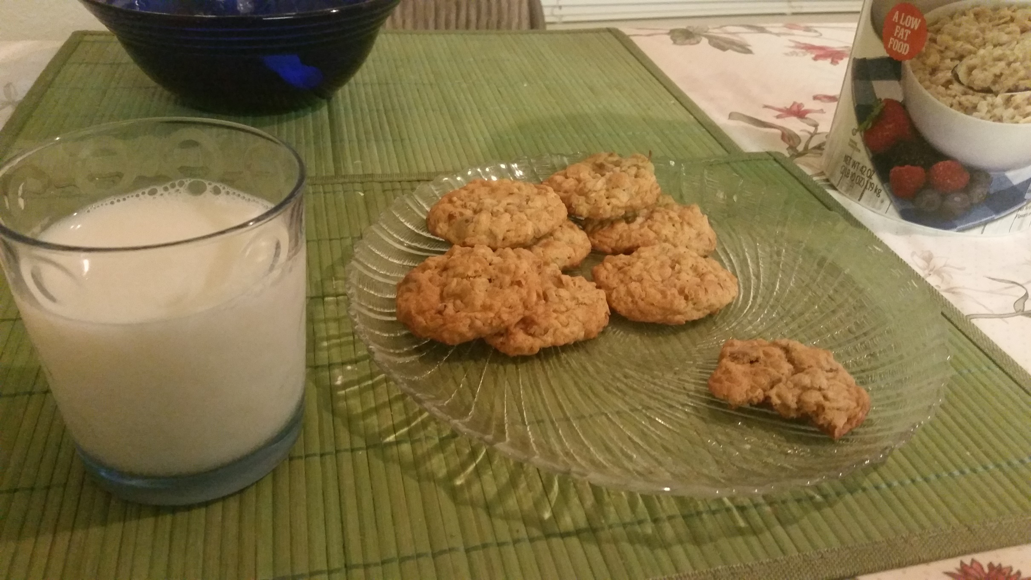
Enjoy!

