Slide 1
Comparing Two
Comparisons

Slide 2
List of Adjectives
1 Ugly
2 Beautiful
3 New
4 Old
5 Interesting
6 Modern
7 Spectacular
8 Cheap
9 Nice
10 Tall
11 Large
12 Pretty
13 Happy
14 Absurd
15 Good
16 Bad
17 Amazing
18 Terrible
19 Disgusting
20 Easy
21 Messy
22 Organized
23 Handsome
24 Delicious
25 Expensive

Slide 3
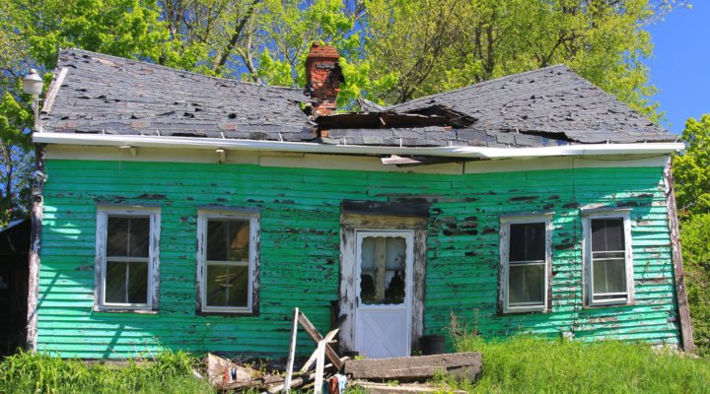
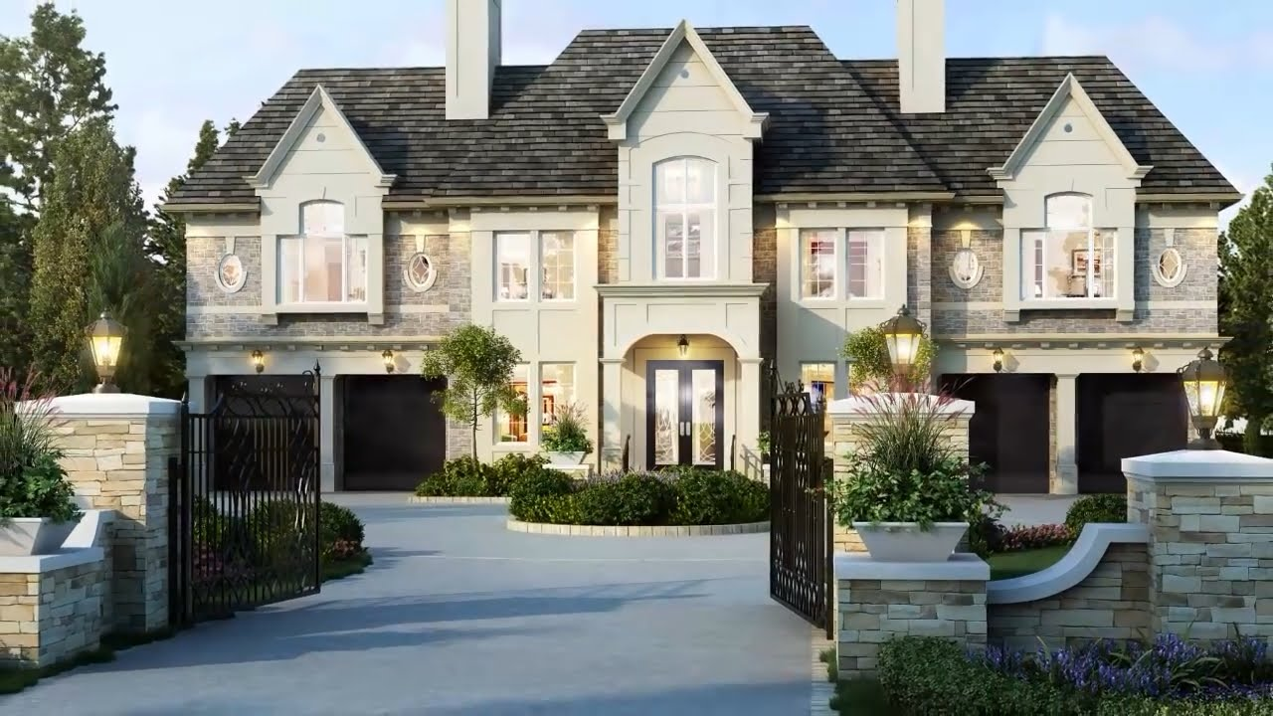
First house
Second house

Slide 4
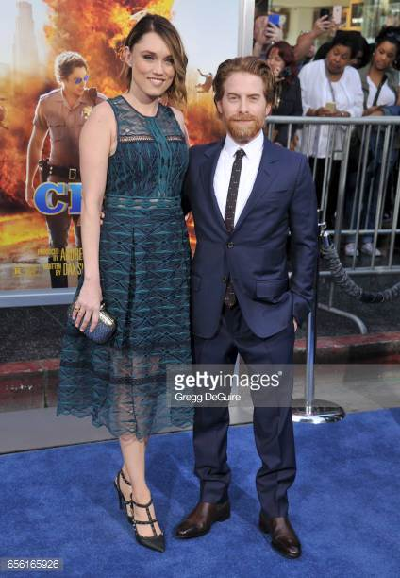

Slide 5
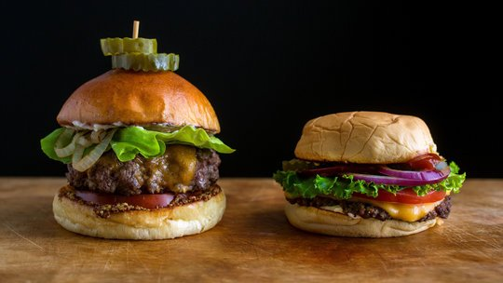
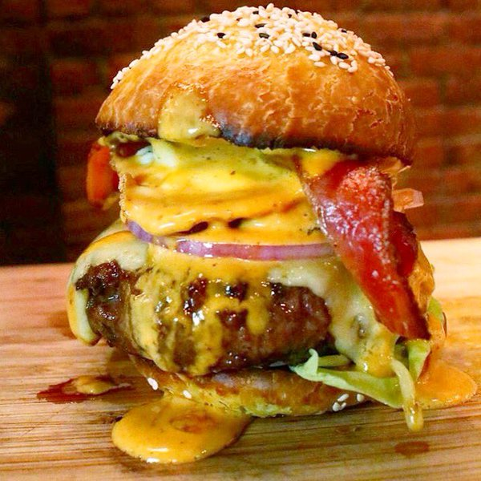
Elegant burger
Pub burger

Slide 6
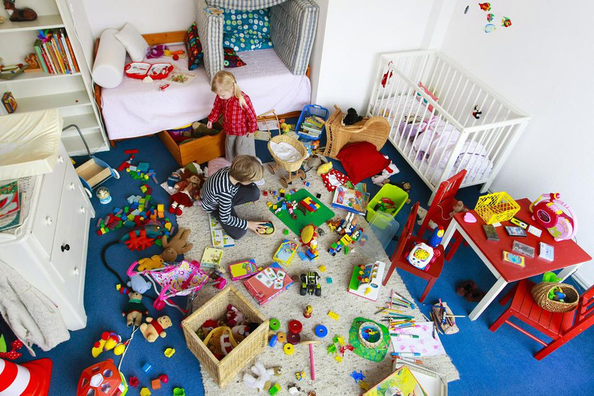
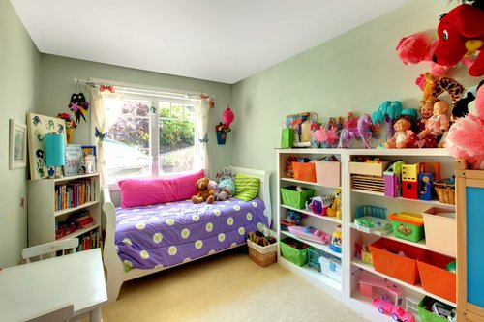
Tom and Meg’s room
Sally’s room

