Slide 1
ESLG 223
One/Ones/A/An/The

Slide 2
Ask one of these questions to a classmate:
Could I have one?
May I have a ________(color) one?
I would like the ________ (color) ones.
Do you have any?
Could I have some?

Slide 3
What is the person asking for?
May I have the blue one?
Could I have the green ones?
I want a blue one.
I need the red one.
Let me have a red and green one.
Could I have a red one and a green one?

Slide 4
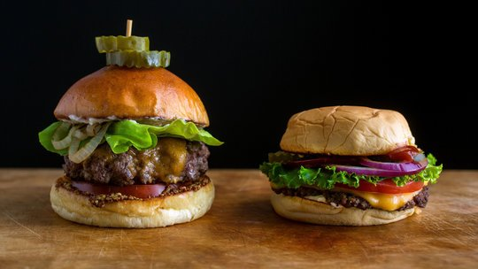
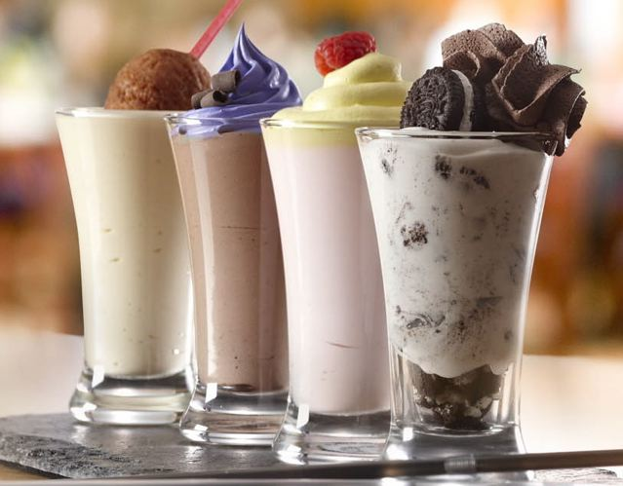
4th
1st
2nd
3rd

